Slide 1
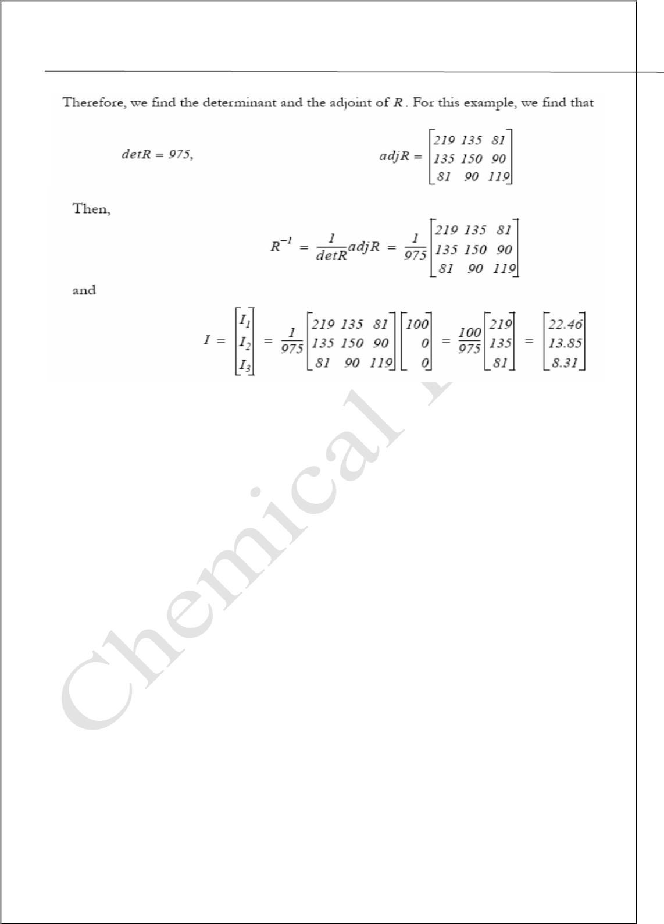
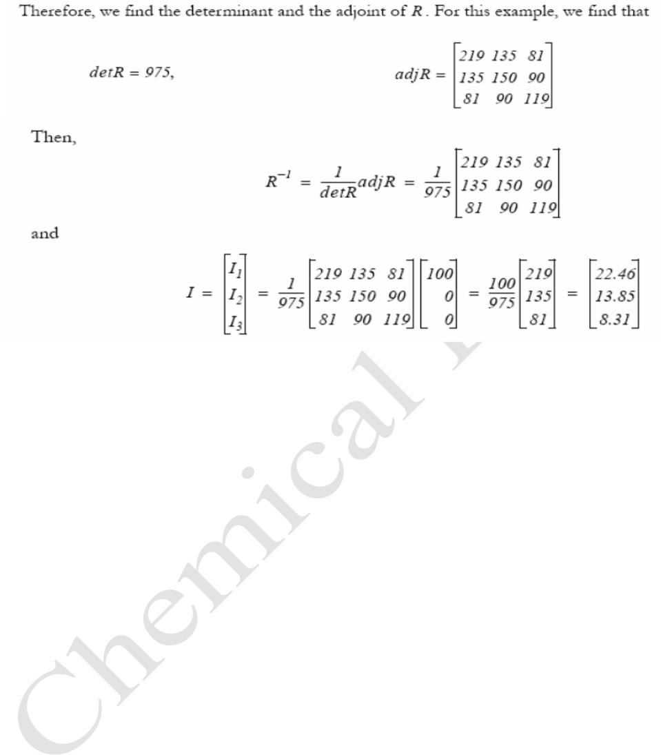
Assistant Lecturer
MatLab
Diyala university/College of Engineering
Omar Abbood Imran
Chemical Department
Second Class
2015 – 2016
Trail Version
Trail Version
Trail Version
Trail Version
Trail Version
Trail Version
Trail Version
Trail Version
Trail Version
Trail Version
Trail Version
Trail Version
Trail Version
Check with MATLAB:
%----------------------------------------------------------
clc
clear
R=[10 -9 0; -9 20 -9; 0 -9 15];
V=[100 0 0]';
I=R\V;
disp('I1=');
disp(I(1))
disp('I2=');
disp(I(2))
disp('I3=');
disp(I(3))
M=inv(R)*V
%-----------------------------------------------------------
Reference
• Chemical Engineering Computation with MATLAB®, 1st Edition, Professor Yeong Koo
Yeo teaches chemical engineering at the College of Engineering of Hanyang University,
Seoul, South Korea.
• Essential MATLAB for Engineers and Scientists, Fourth Edition, Brian H. Hahn,
Daniel T. Valentine
• Essential MATLAB for Engineers and Scientists, Fifth Edition, Brian H. Hahn, Daniel
T. Valentine
61

